Slide 1
HUFFMAN DECODER/ENCODER WITH READING AND WRITING TO FILES
Team members :
Bassant Yasser Abdulsalam 19102749
Yara Adel Hassan 19100683

Slide 2
The idea of Huffman

Slide 3
a Huffman code is a particular type of optimal prefix code that is commonly used for lossless data compression. The process of finding or using such a code proceeds by means of Huffman coding, an algorithm developed by David A. Huffman while he was a Sc.D. student at MIT, and published in the 1952 paper "A Method for the Construction of Minimum-Redundancy Codes". The output from Huffman's algorithm can be viewed as a variable-length code table for encoding a source symbol (such as a character in a file). The algorithm derives this table from the estimated probability or frequency of occurrence (weight) for each possible value of the source symbol. As in other entropy encoding methods, more common symbols are generally represented using fewer bits than less common symbols. Huffman's method can be efficiently implemented, finding a code in time linear to the number of input weights if these weights are sorted.However, although optimal among methods encoding symbols separately, Huffman coding is not always optimal among all compression methods - it is replaced with arithmetic coding.or asymmetric numeral systems if a better compression ratio is required.

Slide 4
Hafuman encoding steps:
Calculate the frequency of each character in the string.
Sort the characters in increasing order of the frequency. These are stored in a priority queue
1.Make each unique character as a leaf node.
2.Create an empty node z. Assign the minimum frequency to the left child of z and assign the second minimum frequency to the right child of z. Set the value of the z as the sum of the above two minimum frequencies.
3.Remove these two minimum frequencies from Q and add the sum into the list of frequencies (* denote the internal nodes in the figure above).
4.Insert node z into the tree.
5.Repeat steps 3 to 5 for all the characters.

Slide 5
The application run

Slide 6
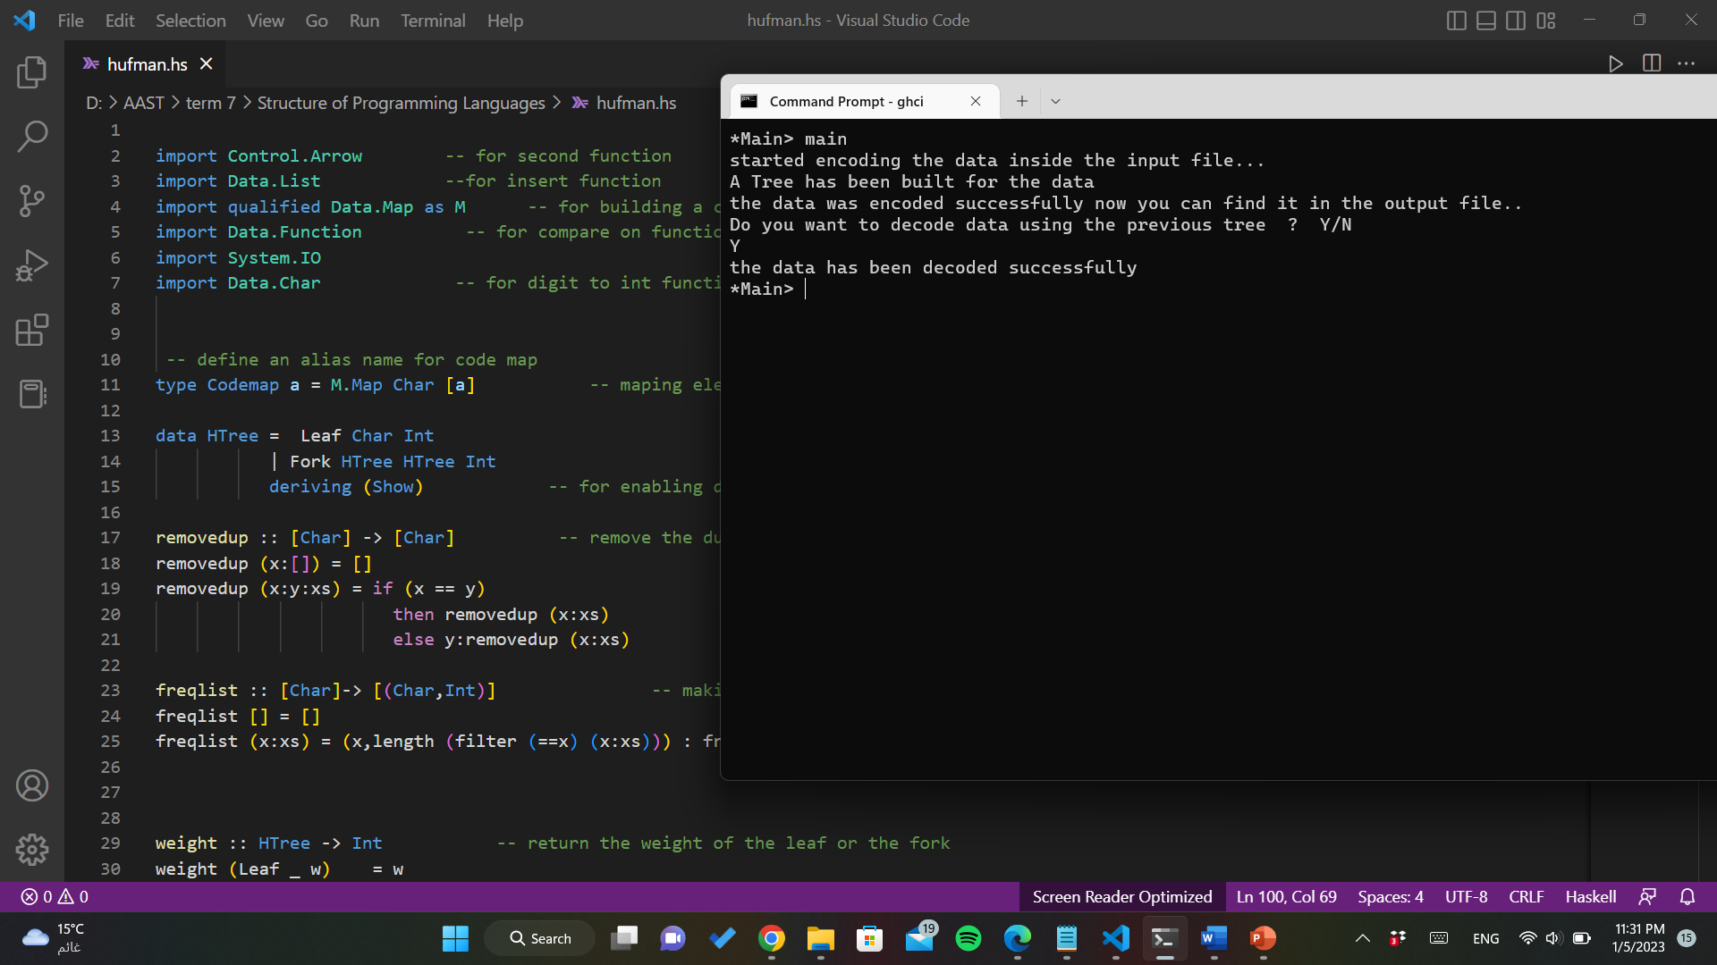

Slide 7
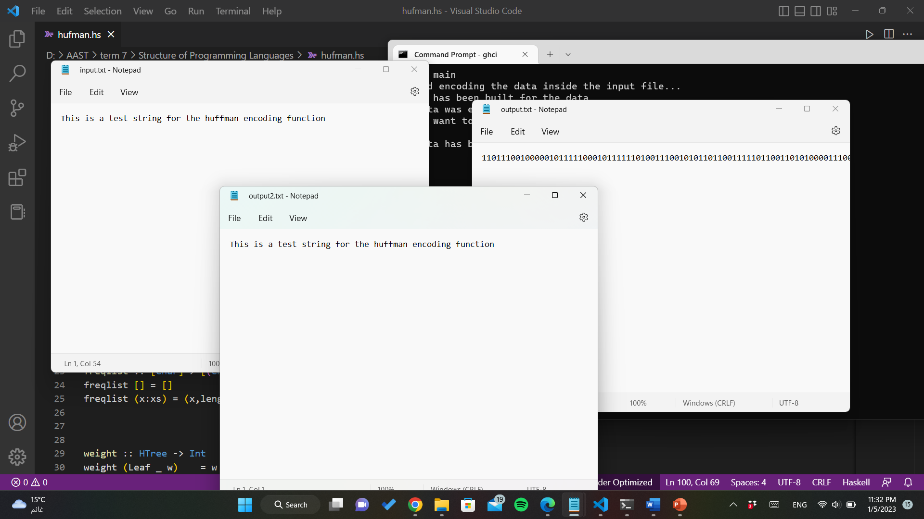

Slide 8
Explanation

Slide 9
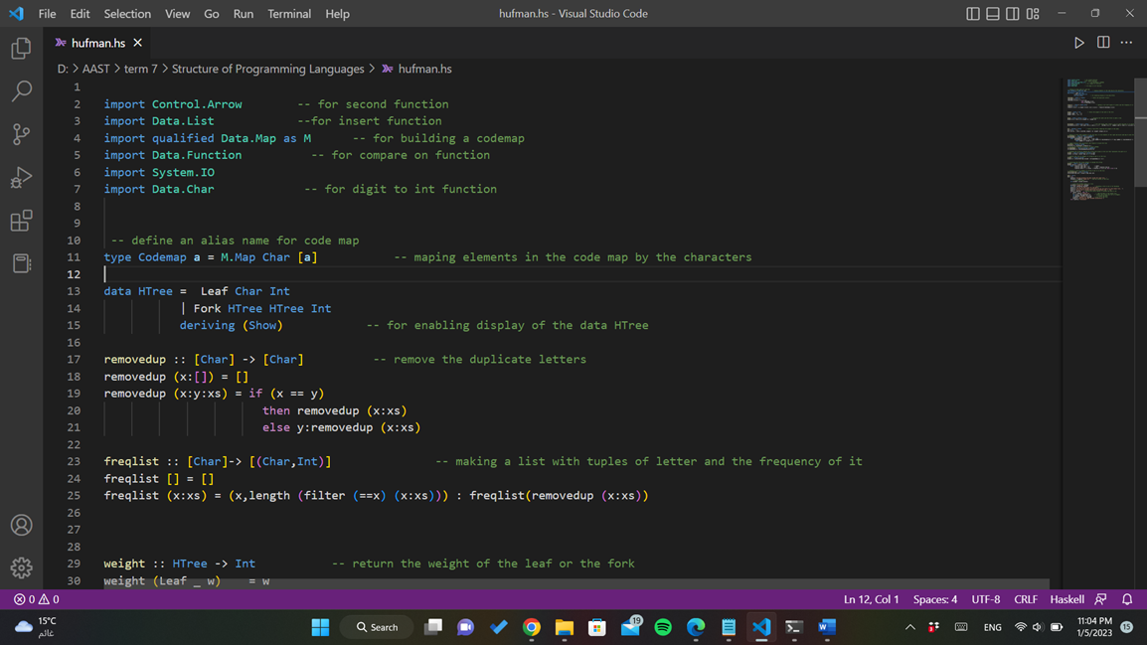

Slide 10
First making an alias for codemap that maps with a char key to it’s corresponding list of integers
Then the next part defines a tree type with leaf and fork
The function remove duplicate takes a list of char and removes the duplicates of the letters
Freq list makes a tuple of a letter and the number of its occurrences
Weight function takes a tree type and return it’s wight (number of occurrences)

Slide 11
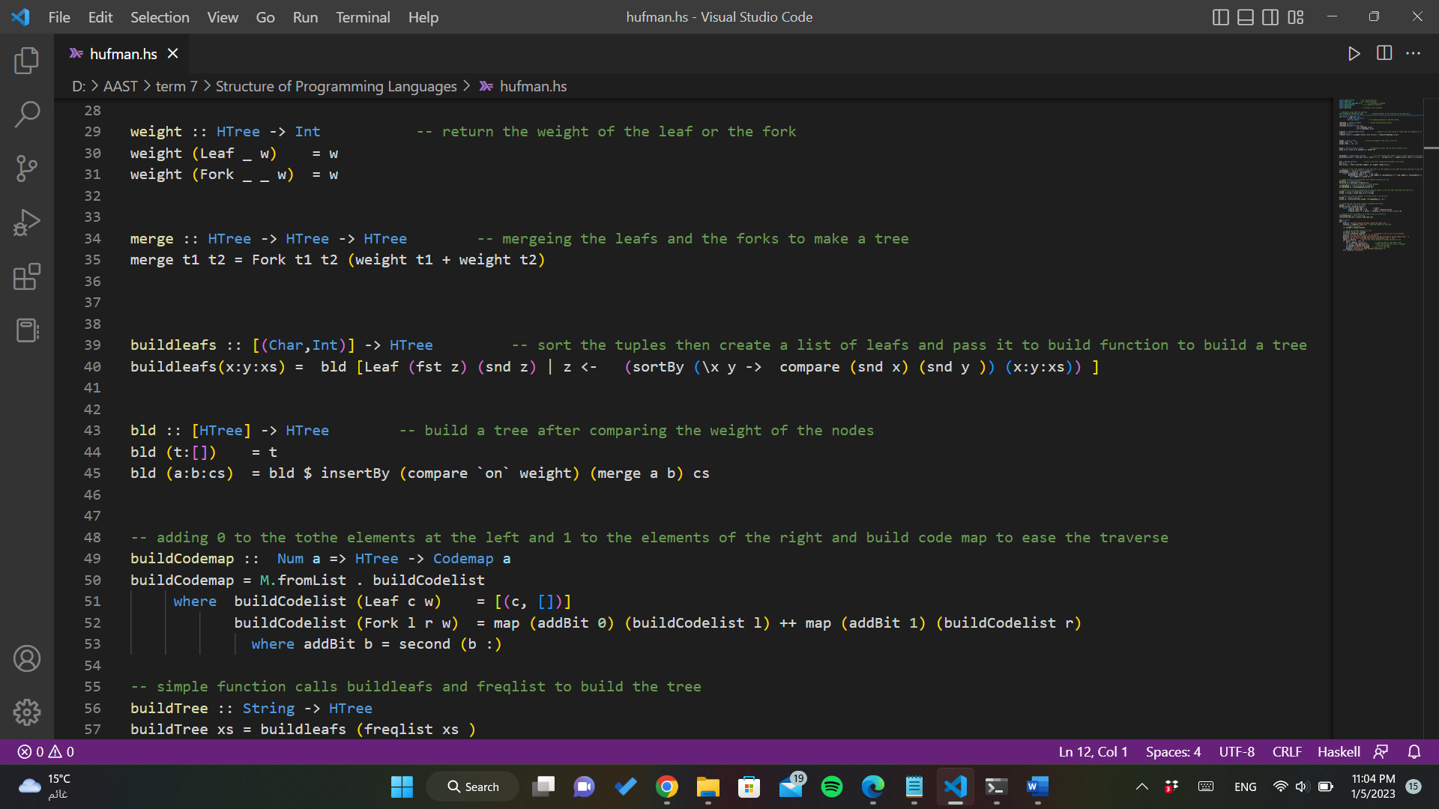

Slide 12
Merge function takes two nodes and then merge them to make a sub tree
Buildleafs function sorts the letters by comparing their num of occurrences and the make a list of leafs and call function bld to merge them and make a tree
Bld function compares subtrees or leafs by their weight and then merge them
Build code map function makes a code map of a letter and the way through which the letter could be found in the tree
Build tree function imple function calls buildleafs and freqlist to build the tree

Slide 13
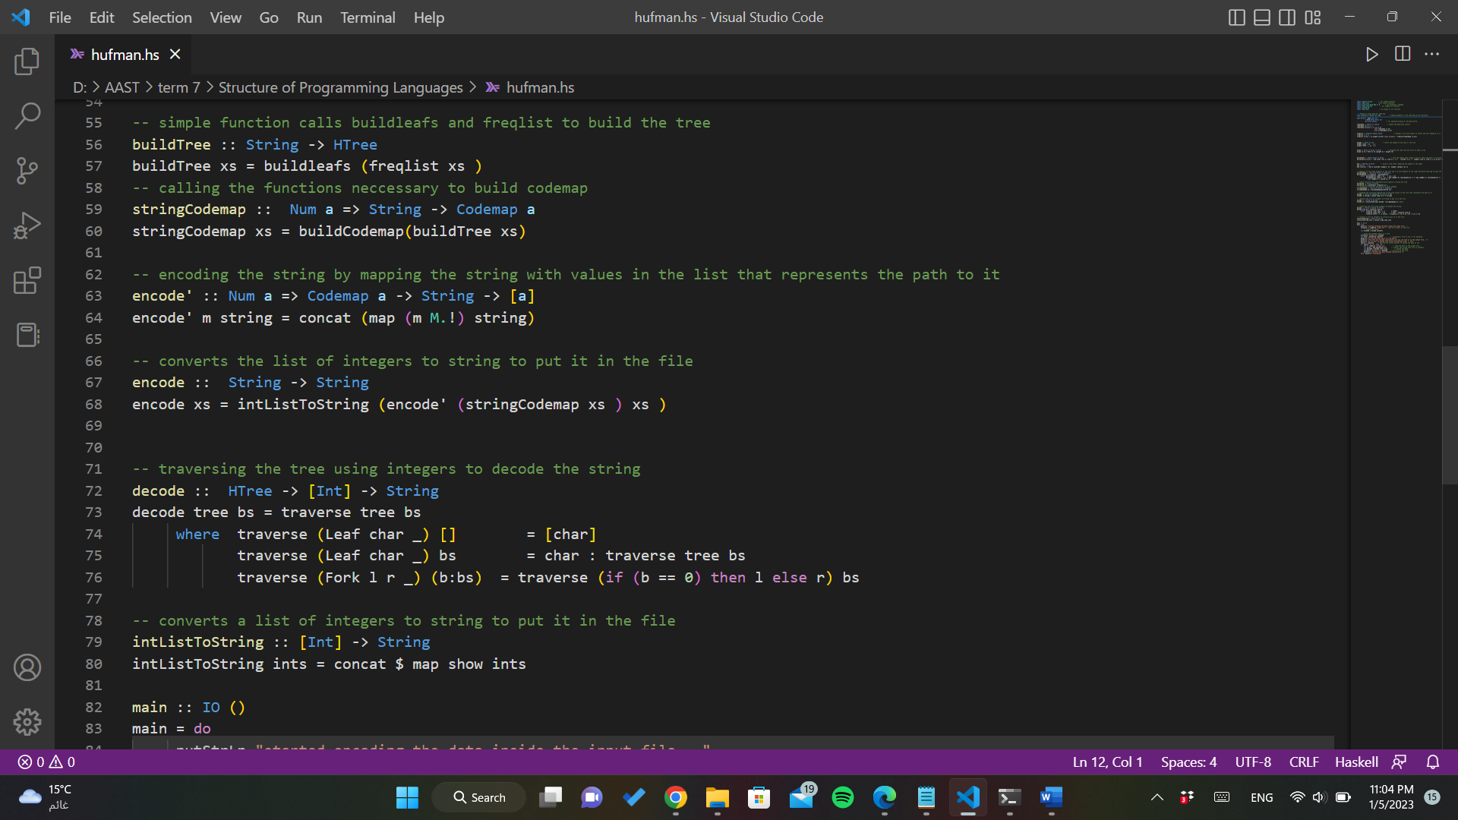

Slide 14
String code map function calling the functions neccessary to build codemap
Encode’ function takes a code map and maps between a character and the path through which it can be reached and then concat all the integer lists together to encode the string
Encode function calls encode’ function and convert the list of int to string of numbers like”101011”
Decode function takes a tree and the encoded value and traverse the tree to find the corresponding letters to build the string
IntListToString function converts an int list to string to put it in the output file

Slide 15
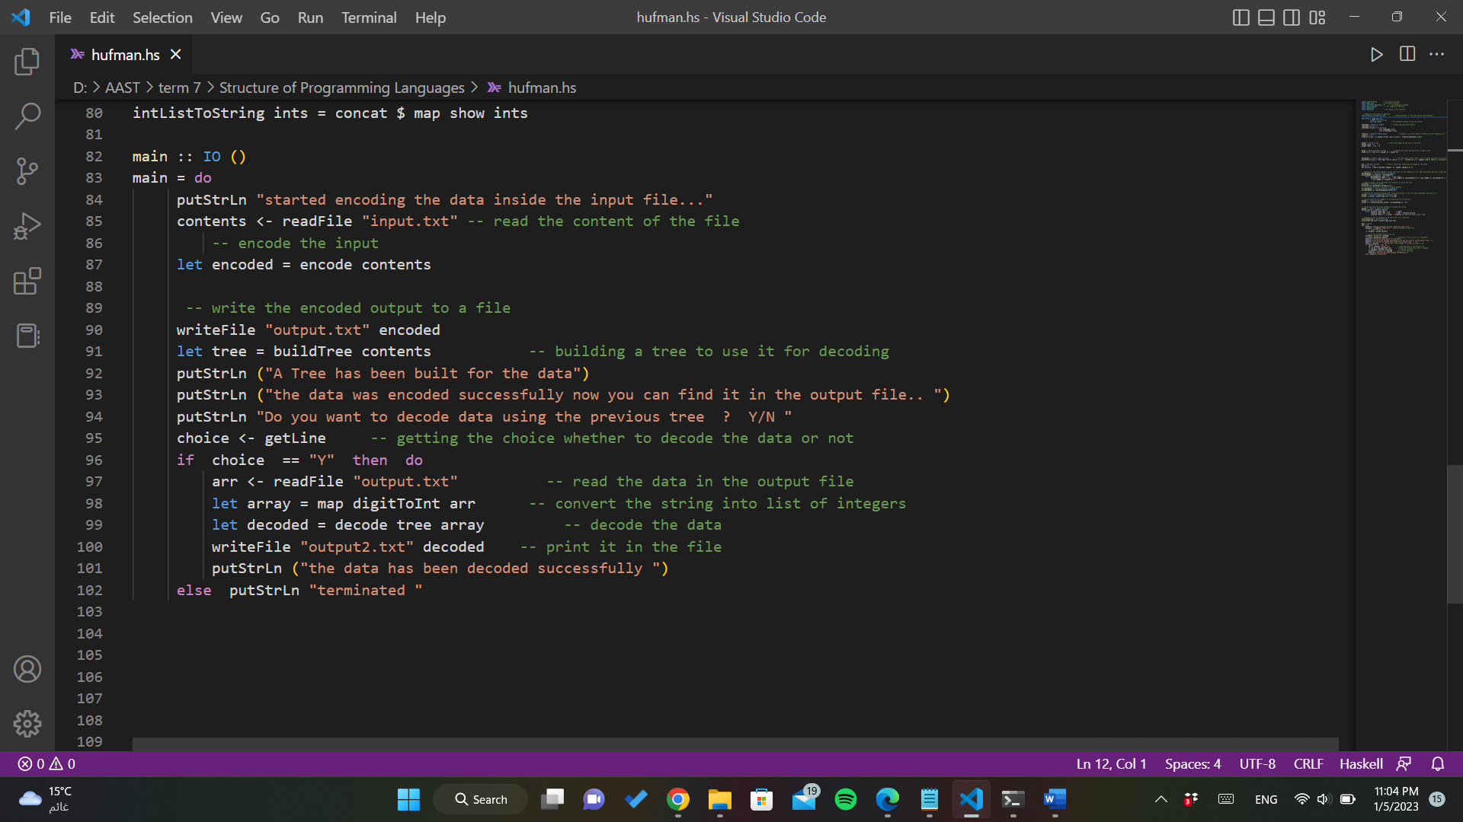

Slide 16
Main function reads the content of the input file to take a string and then calls encode function then write the encoded value to the output file then builds a tree to use it later in decoding
Then gives the user the choice if they wants to decode the data again
If so then the data in the output file will be read and call decode function after converting the list of string of numbers into integer type then the data will be printed in the output2 file
Else the program will terminate

